Slide 1

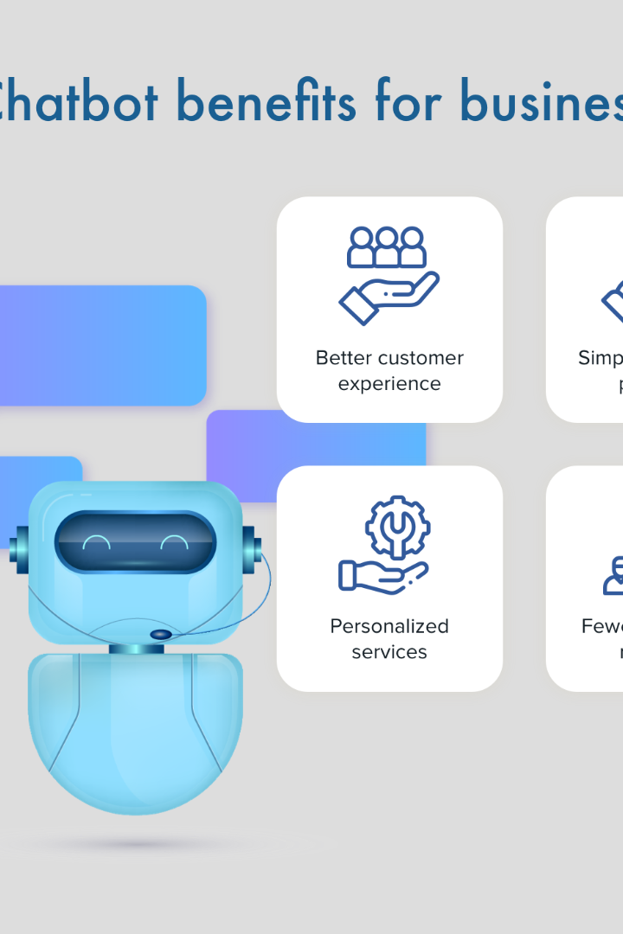


Building a Chatbot Using Python
Welcome to our presentation on building a chatbot using Python. In this session, we will explore the benefits of chatbot development, discuss why Python is an excellent choice for building chatbots, and guide you through the process of creating your own functional chatbot step-by-step.
by KAVIYARASU M

Slide 2

What is a Chatbot?
A chatbot is a software application designed to simulate human conversation through text or voice interactions. It employs natural language processing (NLP) techniques to understand user input and generate appropriate responses autonomously.

Slide 3

Why Use Python to Build a Chatbot?
1
Simple and Effective
2
Rich Ecosystem
Python's intuitive syntax and vast array of libraries make it an ideal language for chatbot development. Its simplicity enables quick prototyping and efficient implementation of complex algorithms.
Python offers a wide range of packages and libraries, such as Natural Language Toolkit (NLTK) and TensorFlow, that greatly simplify the implementation of natural language understanding (NLU) and machine learning algorithms required for chatbot development.
3
Great Community Support
The Python community is incredibly active and supportive, offering a wealth of resources, tutorials, and code repositories that can help developers at all skill levels build powerful chatbots.

Slide 4
Getting Started with Python Chatbot Development
1
Setting up the Development Environment
2
Install Python, choose an IDE or text editor, and set up a virtual environment to isolate your chatbot development environment.
Installing Necessary Libraries and Packages
Install libraries like NLTK and TensorFlow to leverage their powerful NLP and machine learning capabilities in your chatbot development.
3
Building a Chatbot Using Python
Design the chatbot's functionality and conversational flow, implement NLP techniques for user input understanding, and integrate the chatbot with messaging platforms or websites.

Slide 5
Testing and Refining the Chatbot
Debugging and Resolving Issues
Gathering User Feedback
Iterating and Improving Performance
Thoroughly test your chatbot, identify and fix any bugs or errors, ensuring smooth and error-free user interactions.
Collect feedback from users on their experience with the chatbot, identify areas for improvement, and incorporate their suggestions into future iterations.
Continuously refine and enhance your chatbot by incorporating new features, increasing its capability to provide accurate and meaningful responses, and optimize its performance.

Slide 6
Conclusion
Benefits and Uses of a Python Chatbot
Open for Questions and Further Discussions
Recap the advantages of building chatbots using Python, including enhanced user experience, increased efficiency, and improved customer support.
Engage with the audience, address any questions they may have, and encourage further discussions about chatbot development and Python.

